Slide 1
Drought
Interpreting rainfall data

Slide 2
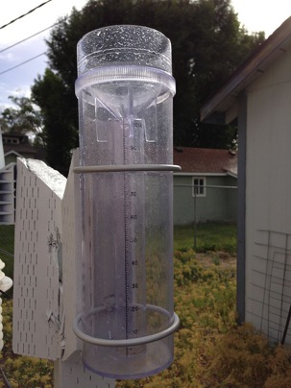
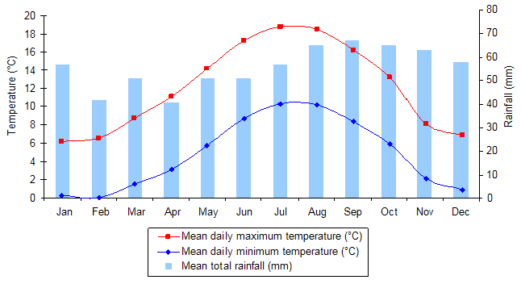
What is rainfall history?
Rainfall history is a collection of data about rainfall in a specific region.
The data provides an overview of wet and dry periods and can be recorded monthly and daily.
The data can be displayed in tables or graphs to compare data over time.
Famartin (2013), A 4-inch plastic rain gauge, https://commons.wikimedia.org/wiki/File:2013-06-24_17_39_11_A_4-inch_plastic_rain_gauge_typical_of_those_used_by_the_CoCoRaHS_program.jpg CC BY-SA 3.0 http://creativecommons.org/licenses/by-sa/3.0/deed.en

Slide 3
What is a drought?
A drought is an acute water shortage caused by lengthy periods of below average rainfall.
Drought is declared when the rainfall is significantly less in an area over three months.

Slide 4
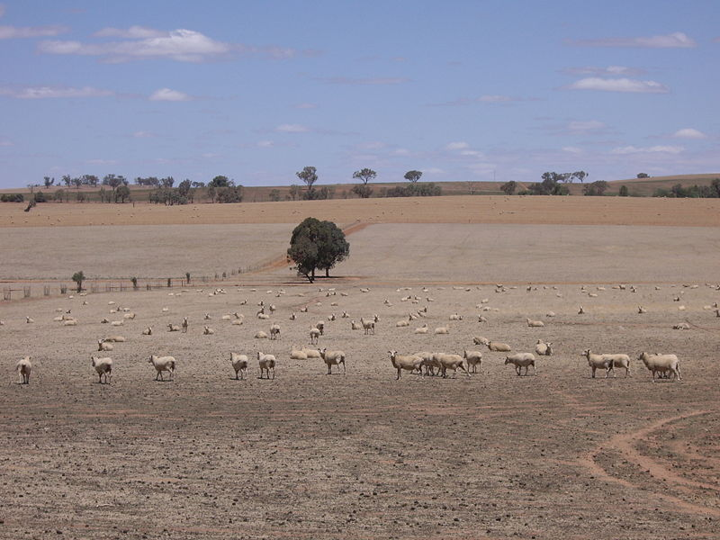
Virtual Steve 2007, Riverina sheep during drought, https://commons.wikimedia.org/wiki/File:Riverina_Sheep_(during_drought).jpg CC BY-SA 3.0 https://creativecommons.org/licenses/by-sa/3.0/deed.en

Slide 5
Declaring a drought
The Australian Bureau of Meteorology measures and monitors rainfall history at many different locations across Australia.
Droughts are declared when the rainfall (quantity) in a specific region (area) over a period of three months (time) is significantly reduced.

Slide 6
Drought affects the Earth’s surface
Erosion occurs
Change in soil quality and loss of top soil
Movement of water tables
Vegetation dies (including forests and crops)
Loss of drinking water
Rivers, dams and reservoirs shrink or dry up
Ecological damage to terrestrial and aquatic organisms and populations

Slide 7
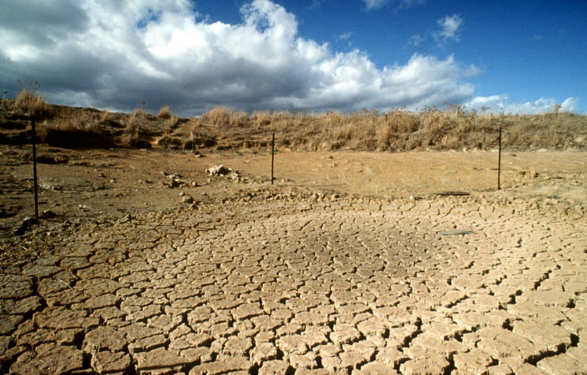
CSIRO 2000, A drought stricken paddock, https://commons.wikimedia.org/wiki/File:CSIRO_ScienceImage_429_Drought_Effected_Landscape.jpg CC BY-SA 3.0 https://creativecommons.org/licenses/by-sa/3.0/deed.en

Slide 8
Drought affects people
Droughts can affect people in urban cities, rural and coastal towns as well as remote areas of Australia.
For example:
Loss of income and increased costs for farmers
Land values decline
Loss of jobs in industries reliant on natural resources
Health issues increase (dust, depression, water quality)
Increased costs to access/transport clean water and food
Loss of community services
Limited recreational activities

Slide 9
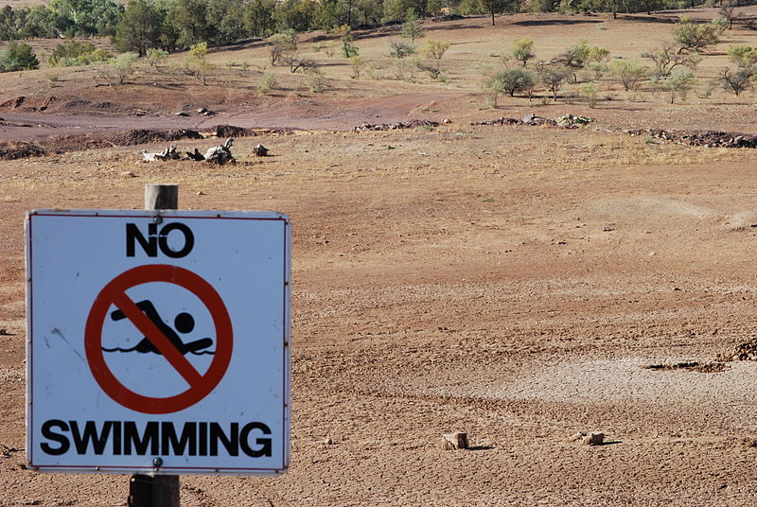
Peripitus 2008, Drought swimming hole, https://commons.wikimedia.org/wiki/File:Drought_Swimming_Hole.JPG CC BY-SA 3.0 https://creativecommons.org/licenses/by-sa/3.0/deed.en

Slide 10
Below average rainfall
This is declared when a region experiences less than 30 per cent of the average rainfall for one month.
Data sourced from: © Commonwealth of Australia (Bureau of Meteorology http://www.bom.gov.au/ ) 2013.

Slide 11
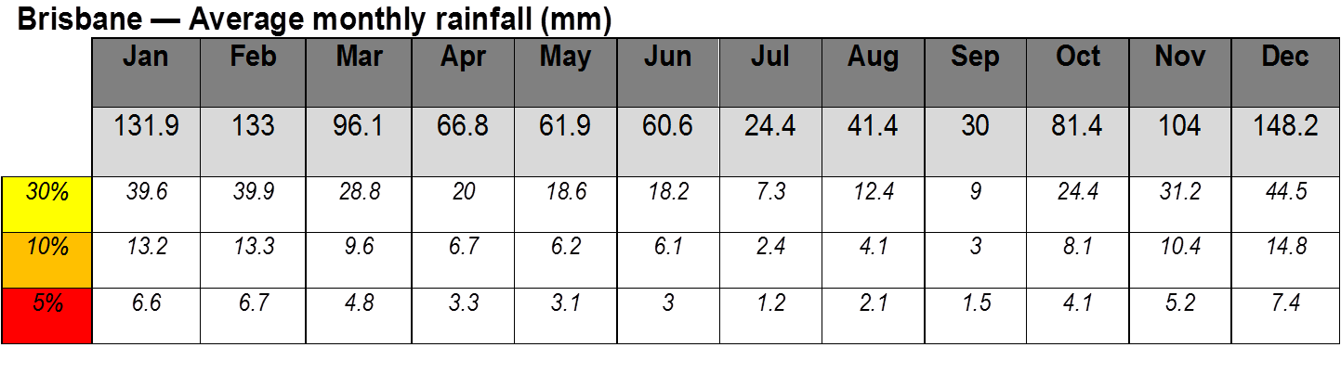
Serious drought
This is declared when a region experiences monthly rainfall that is between 5–10 per cent of the average for three or more months.
Data sourced from: © Commonwealth of Australia (Bureau of Meteorology http://www.bom.gov.au/ ) 2013.

Slide 12
Severe drought
This is declared when a region experiences monthly rainfall that is below 5 per cent of the average for three or more months.
Data sourced from: © Commonwealth of Australia (Bureau of Meteorology http://www.bom.gov.au/ ) 2013.

Slide 13
Predicting the end of a drought
Rain can occur during a declared period of drought.
A drought is only considered broken when rainfall consistently exceeds 70 per cent of the average for three consecutive months.
State and federal governments are responsible for officially declaring the end of a drought.

